Slide 1
MACHINE LEARNING REINFORCEMENT
BANK CUSTOMER CHURN PREDICTION
KAVIYA C
DADS[July]
10/11/2025

Slide 2
INTRODUCTION
Problem Overview
  Banks often lose customers due to churn, impacting revenue.
  Predicting churn helps in proactive retention strategies.
Dataset Overview
The Dataset contains 10000 rows and 12 columns like Credit Score, Age, Balance, Products, Churn status.
Objective
Build a machine learning models to predict which customers are likely to churn.

Slide 3
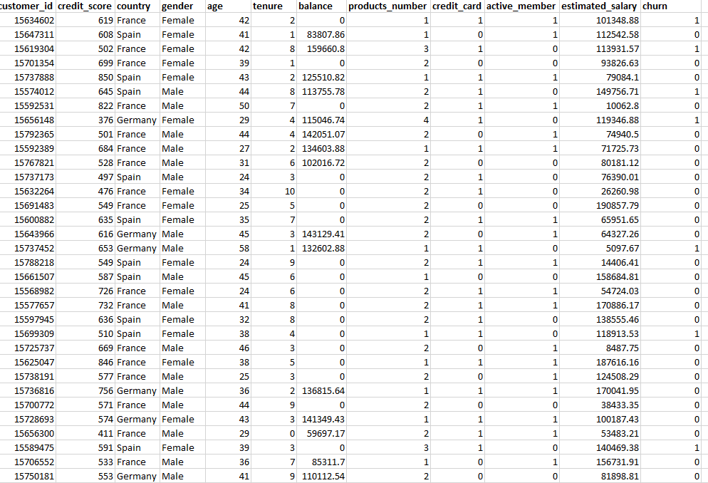
DATA UNDERSTANDING
Dataset Description
12 features capturing demographics, account details, and churn.

Slide 4
DATA CLEANING
Checked for missing/null values.
Dropped Customer ID column.
Encoded categorical features: Gender mapped, Country label encoded.
Removed outliers in Credit Score, Age, Number of Products using IQR.

Slide 5
EXPLORATORY DATA ANALYSIS (EDA)
Univariate Analysis
Histograms and boxplots for numerical features, count plots for categorical features.
Bivariate Analysis
Boxplots and bar charts for feature vs Churn.
Correlation Heatmap
Shows relationships among numerical features.
.

Slide 6
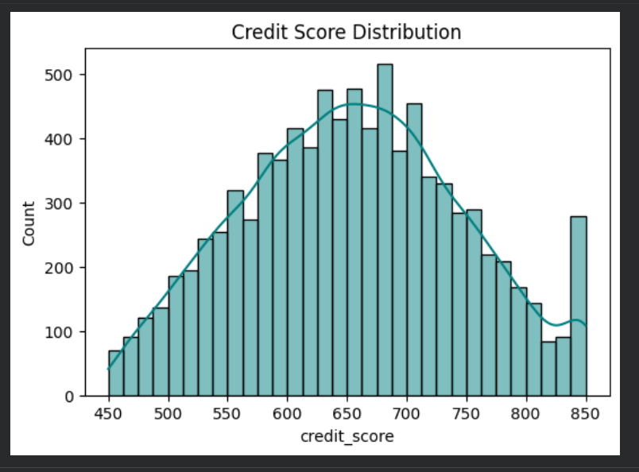
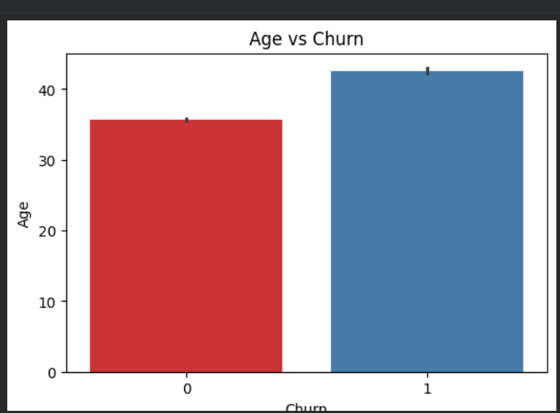
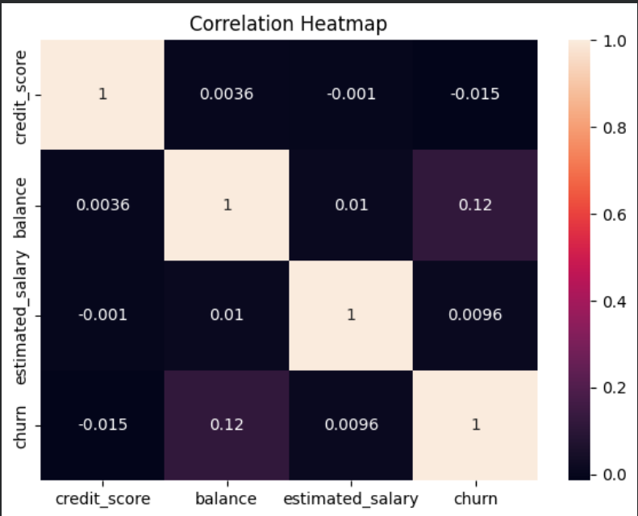

Slide 7
MODELING PROCESS
Models Used
  Logistic Regression
  SVM
  KNN
  Decision Tree
  Random Forest
  XGBoost.
Evaluation Metrics
  Accuracy,
  Precision,
  Recall,
  F1-Score.

Slide 8
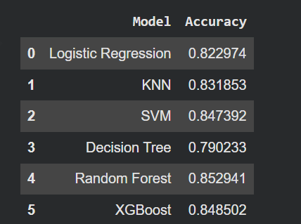
MODEL COMPARISON
The Best Performing Model is Random Forest with the highest Accuracy 0.85

Slide 9
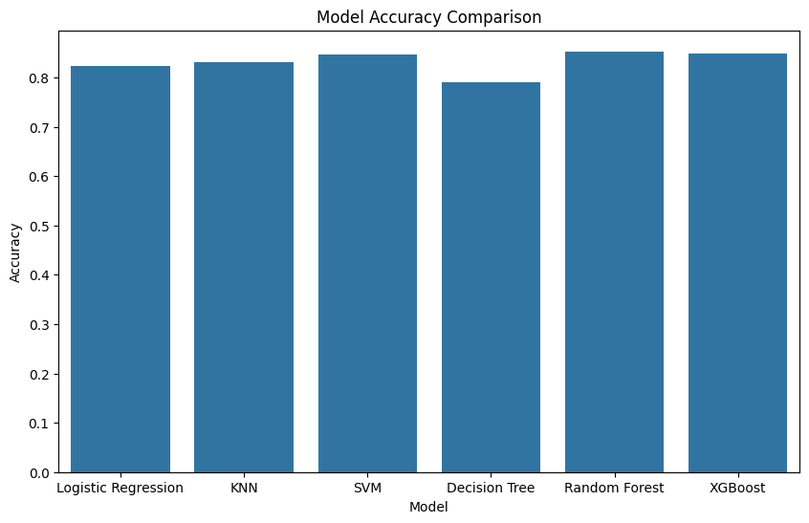

Slide 10
CONCLUSION
  Data cleaning, EDA, and model training provided insights into churn patterns.
  Random Forest performed best with high accuracy and balanced precision-recall.
  Improvements: Include behavioral data, try advanced ensemble models, fine-tune hyperparameters.
  Future Steps: Deploy model for real-time predictions, design targeted retention strategies, monitor performance over time.

